Slide 1
ITAC REVIEW
Image build automation using Packer
Project PPM # 217853
Venkatesan Ramanathan
04/18/2018
ITAC Presentation Template: Version Apr2017

Slide 2
Prior ITAC Presentations, Timelines, and Funding
Has project/proposal been previously reviewed at ITAC?
If yes, list below (replacing sample entries):
Type of ITAC approval requested for this presentation
Design Review
Anticipated Project Timelines
Current Phase of Project : Define
Estimated Implementation Date : 05 / 08 / 2018
Funding
Has Project Received AR Funding?: Yes
Initial AR target date: TBD
Additional AR target date (if relevant):
Type of Review | Date | Result (approved / not approved)
ITAC Presentation Template: Version Apr2017

Slide 3
Business Objective
Project Objective:
This project will automate bank-approved Windows ,Linux & JWS Virtual Machine image build and test. Software automation tools will be used to enable the aforementioned tasks to be performed quickly, efficiently, and as hands-off as possible
Reason Project Being Undertaken Now:
Image build is partially automated, and takes significant time to build images from scratch. By automating image build and test, changes or updates to images can be handled quickly, there by reducing the turn around time to use the new images in for VM provisioning
Anticipated Technical Outcome/Benefit (If Appropriate):
1. Introduce image build automation practice within 5/3
2. Reduce the time taken to build new images or update existing images
IT Policies or Standard deviations:
None
ITAC Presentation Template: Version Apr2017

Slide 4








Business Conceptual Design – Image build and test
5
Base image
Repository
Fetch base image
InfoSec.
Upload image
and packages
5
Fetch config scripts
Image
standards
Target image
Repository
1
Trigger
Image test
8
Check-in
config scripts
Trigger
Image build
Initiate
Image build
Upload image
2
3
6
Update image
metadata
4
Jenkins
Packer
Inspec
9
Developer
Update Image build status
Update test
outcome
10
7
Glance

Slide 5
Project Name, Project Sponsors, Key Members
Project Name: Image build automation using Packer
Project Sponsors: TBD
Key Project Members: TBD
ITAC Presentation Template: Version Apr2017

Slide 6
IT Involvement To Date
List NPI Risk Rating: TBD
Enterprise Risk Advisor: TBD
Sourcing: Greg, Beck
IT Risk Advisor: Joshua, Gooch
IS Architect: Ramon, Garcia Pinal
Enterprise Architect: J.P. Srinivas
DR & Business Continuity Planning: Darren, Sliwinski
Enterprise Data Management:
Shared Services: Karen, Carr
QA Testing : Eric, Tucker
IT Operations : Michele, McDonel
ITAC Presentation Template: Version Apr2017

Slide 7
Architecture Decisions
Subject Area | Platform | Topic | One Github Repo per major version of Image
Architecture Decision | To have one Github enterprise repository for each major version of an Image
Problem statement & Requirements | Image and associated packages and configuration scripts should be isolated from those that belong to other images
Assumptions | Server teams have access to Github enterprise platform Appropriate permissions are provided to the team to access the Github repository
Alternatives evaluated | One Github repository for each OS type
Justification | Each major OS version will have multiple minor releases / patch updates / hotfix, and hence requires it’s own repository on Github VMs provisioned using the previous version of the image will not be upgraded at the same time when a new image is build. Hence there will be a necessity to maintain past versions of an image
Implications
Derived Requirements (if any)
Related Decisions
ITAC Presentation Template: Version Apr2017

Slide 8
Architecture Decisions
Subject Area | Platform | Topic | One feature branch per minor release of an image
Architecture Decision | To create a feature branch under the dev branch , for each minor release linked to an image version
Problem statement & Requirements | Need to segregate different releases (for an OS image version)
Assumptions | Server teams have access to Github enterprise platform Appropriate permissions are provided to the team to access the Github repository
Alternatives evaluated
Justification | Per Fifth Third Bank Github standards, each Github repository should always have a master branch and a development branch The feature branches will be created off the dev branch, and eventually pulled into dev branch The feature branches will be deleted after it is pulled into dev branch The changes in dev branch will merged into master branch
Implications
Derived Requirements (if any)
Related Decisions
ITAC Presentation Template: Version Apr2017

Slide 9
Architecture Decisions
Subject Area | Platform | Topic | Create Base OVF & AMI image from ISO
Architecture Decision | To create a Base OVF and AMI for each OS type (windows and Linux), and Major version To use the base OVF & AMI image for all new image build (for each minor release / hotfix / patch update)
Problem statement & Requirements | ISO based image build using packer takes significant amount of time ISO based image build failure is difficult to troubleshoot
Assumptions | Fully functional Vmware workstation deployment (on top of Beta and prod Packer servers) Access to Vmware ESX hosts for OVF based image build will be allowed
Alternatives evaluated
Justification | ISO based image build using packer takes lot of time, even when the changes between two image versions are very minor Troubleshooting failure of iso based image build is difficult, as the VMs provisioned by packer during the image build, are deployed on top of Vmware workstation, which itself is deployed as a software within the packer VM
Implications
Derived Requirements (if any) | AWS – Fifth third provided OS licenses instead of pay-per-use-licenses
Related Decisions
ITAC Presentation Template: Version Apr2017

Slide 10
Architecture Decisions
Subject Area | Platform | Topic | AWS – Fifth third provided OS licenses instead of pay-per-use-licenses
Architecture Decision | To build AMI images using ISO, there by provisioning fifth third OS licenses, instead of pay-per-use-licenses
Problem statement & Requirements | Single image build file for all cloud platforms (Vmware, AWS) Single base image for building images for all cloud platforms (Vmware, AWS)
Assumptions | Fifth Third Bank has no licensing restrictions that disallows use of OS licenses on AWS
Alternatives evaluated | Source AMI based image build (pay-per-use-licenses)
Justification | OS image build process should be streamlined for all cloud platforms Same base image should be used for image builds across all platform, to ensure image consistency Same image build file should be used for building images across all cloud platform, to ensure image consistency Source AMI based image build will not be used, as it may not have the packages or configuration which are specific to Fifth Third Bank
Implications
Derived Requirements (if any)
Related Decisions
ITAC Presentation Template: Version Apr2017

Slide 11
Architecture Decisions
Subject Area | Platform | Topic | Separate build pipelines for base image & target image build
Architecture Decision | To have separate pipelines for base image and target image build
Problem statement & Requirements | A separate pipeline for building OVF & AMI base images from ISO Another pipeline for building the target image from the base OVF & AMI
Assumptions | ISO based image build will happen only one time (when a new OS major version is released) All subsequent OS image build will reference the base image built by the previous pipeline
Alternatives evaluated
Justification | The first image built for a major OS version will be a base image (built from ISO) All other images will be built from the base image (OVF / AMI based build) Base image build happens only once (per OS major version) Target image build can happen multiple times (upon minor upgrade, release, hot fix, patches etc.)
Implications
Derived Requirements (if any)
Related Decisions
ITAC Presentation Template: Version Apr2017

Slide 12
Architecture Decisions
Subject Area | Platform | Topic | Image repository for storing images & packages
Architecture Decision | To store the OS image (ISO) in an NFS share To store the application packages in an NFS share & S3 bucket To store the base image (OVF) in an NFS share (for Vmware) To store the base image (ISO) in AWS To store the target image (OVF) in an NFS share (for Vmware) To store the target image (AMI) in AWS
Problem statement & Requirements | For each major OS version, a base image (OVF and AMI) should be built All subsequent image builds will be based on the base image Need a place to store the vendor OS ISO, base image , application packages and target image
Assumptions | ISO based image build will happen only one time (when a new OS major version is released) All subsequent OS image build will reference the base image built by the previous pipeline
Alternatives evaluated | Jfrog
Justification | Jfrog is not implemented yet at the Bank, and cannot be used for storing images NFS share is currently being used for storing images related to private cloud, and hence can be leveraged for packer automation purposes Storage is required for the vendor OS ISO, base image, application packages developed by App teams, and for storing target images (built by packer)
Implications
Derived Requirements (if any) | Config scripts and Packerfile should be stored in Github repository
Related Decisions
ITAC Presentation Template: Version Apr2017

Slide 13
Architecture Decisions
Subject Area | Platform | Topic | Config scripts , packer file and InSpec test cases should be stored in Github Enterprise repository
Architecture Decision | To store image customization and configuration scripts in Github repository To store Packerfile in Github repository To store InSpec test cases in Github repository
Problem statement & Requirements | Need to version control the scripts , Inspec test files & packer file used for Image build
Assumptions | The development team has access to Github Enterprise repository
Alternatives evaluated
Justification | The config scripts , InSpec test cases and Packerfile are not stored in a code repository and they are not version controlled Changes to the script , Inspec test cases and Packerfile should be version controlled
Implications
Derived Requirements (if any)
Related Decisions
ITAC Presentation Template: Version Apr2017

Slide 14
Architecture Decisions
Subject Area | Platform | Topic | Trigger image build on pull request event
Architecture Decision | When a new image build needs to be triggered, a pull request will be issued. The pull request event will be monitored by Jenkins pipeline to initiate the build
Problem statement & Requirements | Image build should be automatically triggered when new packages and config scripts are ready
Assumptions | Jenkins is integrated with Github enterprise platform
Alternatives evaluated | Trigger image build on each commit Schedule image build
Justification | If multiple changes are being made to the config scripts, then a build trigger on each commit would result in failed image builds Scheduled image build will run even when there are no changes made to the image By triggering build on pull request event, we can ensure the image build happens, only when all the development is completed. Also Jenkins build output can be written back to the pull request to notify the developer of build failure
Implications
Derived Requirements (if any)
Related Decisions
ITAC Presentation Template: Version Apr2017

Slide 15
Architecture Decisions
Subject Area | Platform | Topic | Image validation using InSpec
Architecture Decision | Image will be validated and tested using InSpec
Problem statement & Requirements | Image should be tested to ensure it meets the InfoSec. Standards / requirements
Assumptions | Information security requirements will be provided by the InfoSec team for each OS image
Alternatives evaluated
Justification | The image built using packer should be tested to ensure that it meets the InfoSec requirements / standards The InfoSec criteria will be codified as InSpec test cases VM will be provisioned using the image and the InSpec test cases run against the VM to validate compliance to InfoSec requirement
Implications
Derived Requirements (if any)
Related Decisions
ITAC Presentation Template: Version Apr2017

Slide 16
Architecture Decisions
Subject Area | Platform | Topic | InSpec integration with Jenkins
Architecture Decision | InSpec test output will be exported in Junit format
Problem statement & Requirements | InSpec test output should be reported back to Jenkins as a build outcome (Success / Failure)
Assumptions | Junit plug-in is deployed in Jenkins
Alternatives evaluated
Justification | InSpec test output will be exported in Junit format Jenkins will consume the test outcome and report that as a build success or failure The Inspec test output will be recorded in the Jenkins pipeline log and “tests view”
Implications
Derived Requirements (if any)
Related Decisions
ITAC Presentation Template: Version Apr2017

Slide 17
Architecture Decisions
Subject Area | Platform | Topic | Jenkins integration with Github
Architecture Decision | Jenkins will notify the build status to Github
Problem statement & Requirements | Jenkins build outcome should be reported back to Github
Assumptions
Alternatives evaluated
Justification | Jenkins build outcome will be reported back to Github and tracked against the pull request The developer gets notified by Github, on the status of the pull request (success or failure)
Implications
Derived Requirements (if any)
Related Decisions
ITAC Presentation Template: Version Apr2017

Slide 18
Architecture Decisions
Subject Area | Platform | Topic | Github related Image metadata
Architecture Decision | The Github pull request ID & Jenkins build number will be added as an Image metadata
Problem statement & Requirements | Github pull request ID and Jenkins build number should be updated to Image metadata
Assumptions
Alternatives evaluated
Justification | For each image, we need to track the Github pull request that triggered the automated image build, and the Jenkins build number, in order to validate the image build steps and to access the logs for troubleshooting By enforcing the Github pull request ID and the Jenkins build number as mandatory metadata attributes for an image, we can ensure an audit trail for the image build process
Implications
Derived Requirements (if any)
Related Decisions
ITAC Presentation Template: Version Apr2017

Slide 19
Non Functional / operational Requirements
Capture all relevant operational requirements
Index | Requirement Name | Value(s)
NFR01
NFR02
NFR03
NFR04
NFR05
NFR06
ITAC Presentation Template: Version Apr2017

Slide 20
Checklist – Capacity Planning & Management
Item
Will long term transaction history require additional disk storage? | N/A
What are the product dependencies i.e. database - web presentation - Unix - Mainframe? | N/A
Is it possible to monitor and record application resource utilization? | Y
What is the expected 1st year growth of the product? | Minimal
What is the means for storing archived data and how will data be restored? | N/A
Can the test environment be scaled down and still accomplish adequate testing? | Y
What resources are required for development? | Virtual servers
Is the current work load monitored today for vendor recommendation comparison? | N/A
Has the vendor produced performance statistics from a like sized environment if the product is new to our business? | N/A
What are the product specifications for performance analysis on CPU, Memory, Disk and I/O utilization? | N/A
Can the product function in a shared VMWare environment? | Y
Is the product expandable/scaleable up and down for business expansion and contraction? | Y
Does the solution uses / has any open source technologies (libraries, tools, platforms etc) | Y
ITAC Presentation Template: Version Apr2017

Slide 21
Technology Stack - Automation
Cloud Provider
AWS/VMware
Infrastructure Provisioning
Terraform
Image Build
Packer
Source code management
Github Enterprise
Image build orchestration
Jenkins
Image metadata storage
Glance
Image validation
InSpec
ITAC Presentation Template: Version Apr2017

Slide 22
Technical Views
OS Image build / Pre-provisioning process
New image build process
Image update process
Image management & maturity model

Slide 23
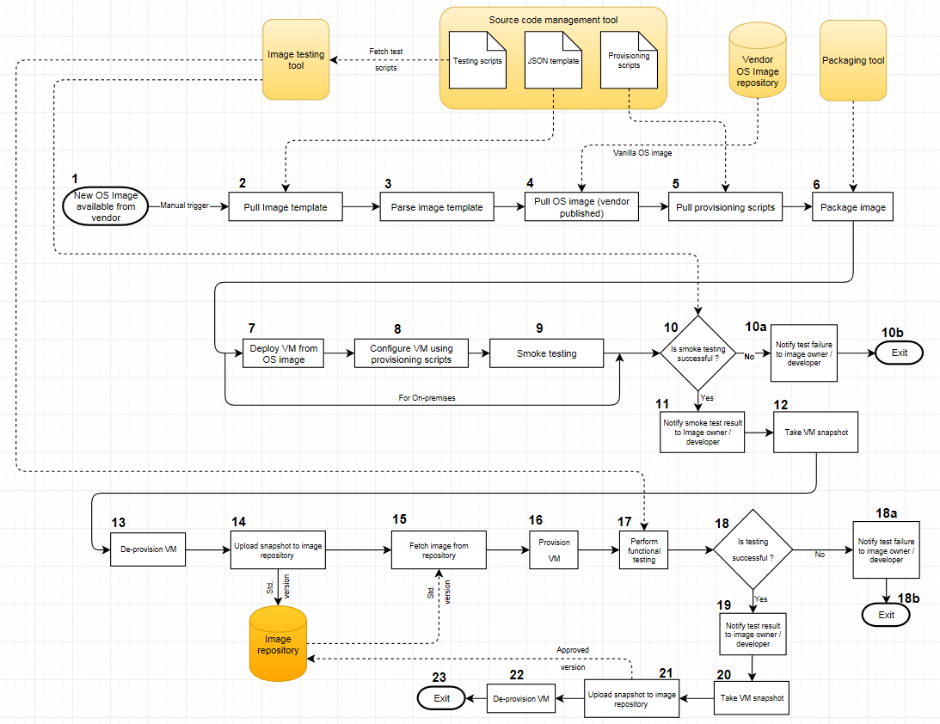
Image build process – Release 1 (when a new OS image is available from vendor)

Slide 24
Image build process – Release 2 (when new standards / policy are published at 5/3)

Slide 25










Hybrid cloud – OS Image Management Model
Dev
QA
Prod
region
Golden
Images
Vanilla
OS, S/W
Images
Private Cloud Environment
Image
Build
Tool
SCM Tool
(Workflows, Scripts
Templates)
VMware Vcenter
VMware Esxi
Golden
Image
Repo

Slide 26
OS Image Adoption – Maturity process

Slide 27
Maintenance & Support
Specify Initial and Ongoing Costs (Out to 3 Years)
Consulting
Hardware
Software
Outside Service Provider
Support
New or Existing FTEs? How many?
Existing
Required Skillsets?
Terraform, Packer
Training
Training required on Hashicorp Terraform suite of products
ITAC Presentation Template: Version Apr2017

Slide 28
Appendix

